Slide 1

Student Record Management System in C
This presentation covers the design and implementation of an efficient student data management solution. The system is implemented in C for optimal performance. It aims to provide a secure and user-friendly way to manage student records.
NAME: Adarsh Singh
UID: 24BCA10542
Section: 8a (BCA)

Slide 2
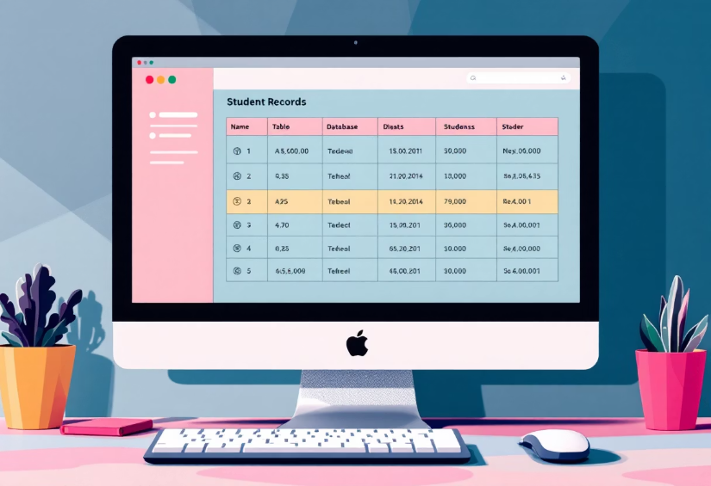
Introduction & Problem Statement
Need for Digital Systems
Digital student record systems are essential. They are important for efficient data management.
Challenges
Data security, access control, and scalability are key challenges.
System Goals
The system aims to be efficient, secure, and user-friendly. Access control and data security are most important.

Slide 3





System Design: Flow Chart
Data Input
User inputs student information.
Processing
Data is processed and validated.
Storage
Records are stored efficiently.
Output
Data is displayed to the user.

Slide 4

Core Functionality: Source Code Highlights
Key Functions
Data Structures
add_student(), search_record(), update_info() are central. These are the most important parts of our code.
The struct student { ... } structure is used. This structure holds student data.
File I/O
File I/O operations ensure data persistence. The system saves student data permanently.

Slide 5
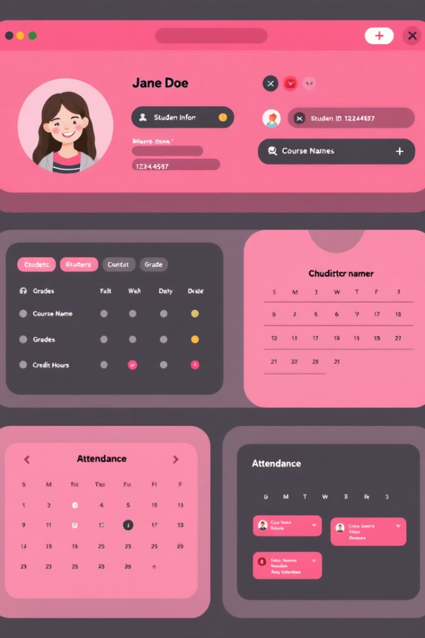




System Output & Demonstrations
Adding Records
Searching
Updating
Report Generation

Slide 6

Testing and Validation
1
Unit Tests
Individual functions are tested.
2
Integration Tests
System modules are tested together.
3
Data Integrity
Validation ensures data accuracy.

Slide 7




Future Enhancements
GUI Implementation
Database Integration
A graphical user interface will enhance usability.
MySQL integration will provide scalability.
User Authentication
User authentication and authorization features will be added.

Slide 8



Conclusion
Future Work
2
Improvements to scalability and features are planned.
Project Success
A functional student record system was created.
1
3
References
Project Documentation

